Slide 1
Sorting

Slide 2
Problem
Results of VIT entrance exam has been released. Given the details of the students such as name, address and marks scored in entrance, write a program to sort the student details so that it will be convenient to call for counselling.

Slide 3
Sorting means . . .
Sorting rearranges the elements into either ascending or descending order within the array (we’ll use ascending order).
36
24
10
6
12
6
10
12
24
36

Slide 4
Sorting also means…
There are several sorting algorithms available like bubble sort, selection sort, insertion sort, quick sort, merge sort, radix sort etc.
Sorting operation is performed in many applications to provide the output in desired order.
For example listing all the product in the increasing order of their names or decreasing order of supplier names
Searching will be easier in a sorted collection of elements
List containing exam scores sorted from lowest to highest or vice versa
We study Bubble Sorting, Selection Sorting and Insertion Sorting in this lab course

Slide 5

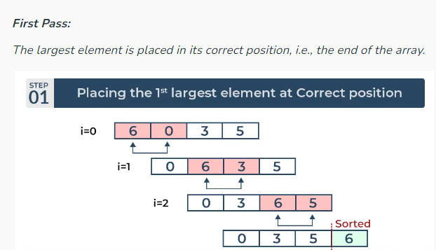
Bubble Sort

Slide 6
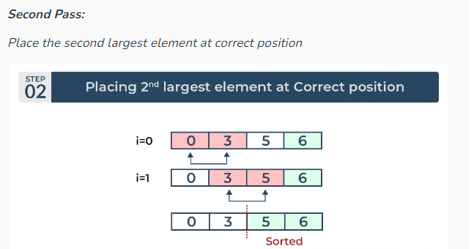

Slide 7
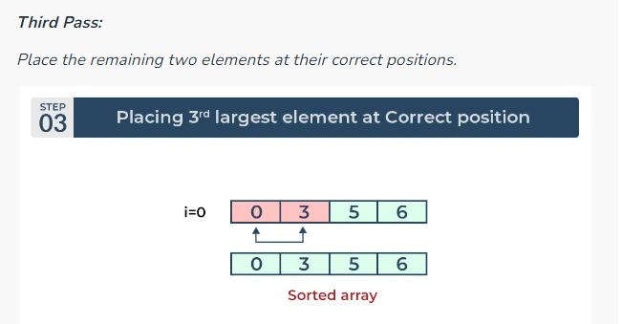

Slide 8
void bubble_sort(int arr[], int n) {
int i, j;
for (i = 0; i < n - 1; i++) {
for (j = 0; j < n - i - 1; j++) {
if (arr[j] > arr[j + 1]) {
int temp = arr[j];
arr[j] = arr[j + 1];
arr[j + 1] = temp;
}
}
}
}

Slide 9
Selection Sort
For the first position in the sorted array, the whole array is traversed from index 0 to 4 sequentially.
The first position where 64 is stored presently, after traversing whole array it is clear that 11 is the lowest value.
Thus, replace 64 with 11.
After one iteration 11, which happens to be the least value in the array, tends to appear in the first position of the sorted list.

Slide 10
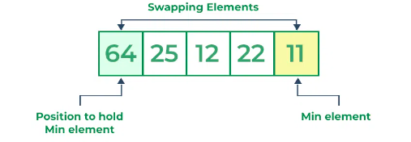
Selection Sort

Slide 11
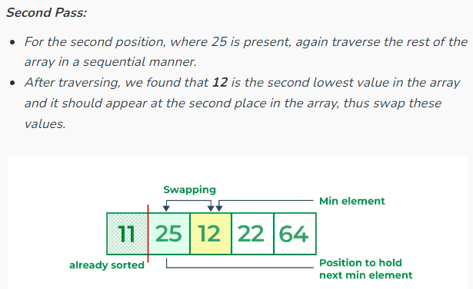

Slide 12
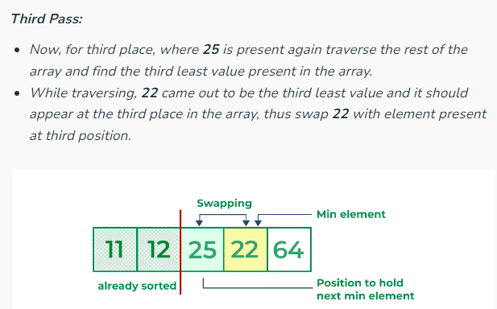

Slide 13
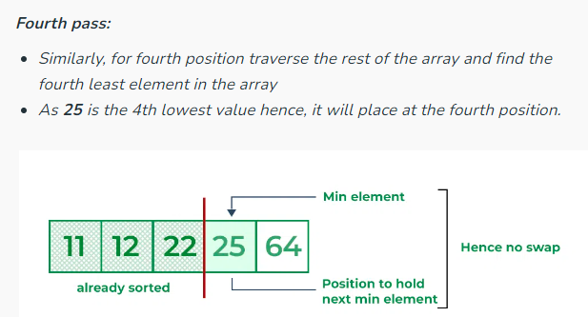

Slide 14
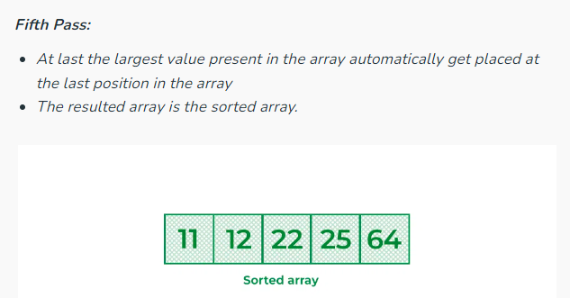

Slide 15
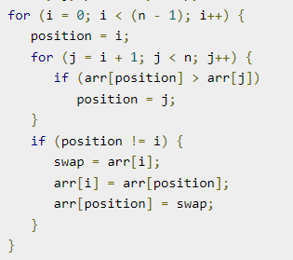
void selectionSort(int arr[], int n)
{
}

Slide 16
Bubble Sort
values [ 0 ]
[ 1 ]
[ 2 ]
[ 3 ]
[ 4 ]
Compares neighboring pairs of array elements, starting with the last array element, and swaps neighbors whenever they are not in correct order.
On each pass, this causes the smallest element to “bubble up” to its correct place in the array.
36
24
10
6
12

Slide 17
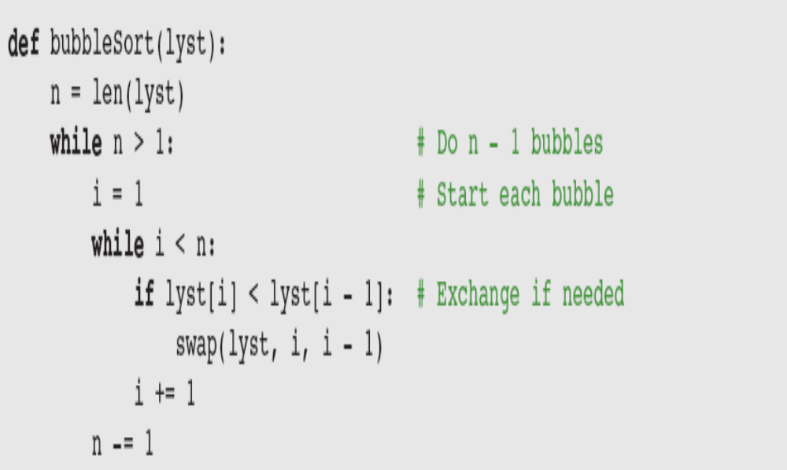
Bubble Sort Pseudo Code

Slide 18
Bubble Sort: Pass One
values [ 0 ]
[ 1 ]
[ 2 ]
[ 3 ]
[ 4 ]
36
24
10
6
12
U
N
S
O
R
T
E
D

Slide 19
Bubble Sort: Pass One
values [ 0 ]
[ 1 ]
[ 2 ]
[ 3 ]
[ 4 ]
36
24
10
6
12
U
N
S
O
R
T
E
D

Slide 20
Bubble Sort: Pass One
values [ 0 ]
[ 1 ]
[ 2 ]
[ 3 ]
[ 4 ]
36
24
6
10
12
U
N
S
O
R
T
E
D

Slide 21
Bubble Sort: Pass One
values [ 0 ]
[ 1 ]
[ 2 ]
[ 3 ]
[ 4 ]
36
6
24
10
12
U
N
S
O
R
T
E
D

Slide 22
Bubble Sort: End Pass One
values [ 0 ]
[ 1 ]
[ 2 ]
[ 3 ]
[ 4 ]
6
36
24
10
12
SORTED
U
N
S
O
R
T
E
D

Slide 23
Bubble Sort: Pass Two
values [ 0 ]
[ 1 ]
[ 2 ]
[ 3 ]
[ 4 ]
6
36
24
10
12
SORTED
U
N
S
O
R
T
E
D

Slide 24
Bubble Sort: Pass Two
values [ 0 ]
[ 1 ]
[ 2 ]
[ 3 ]
[ 4 ]
6
36
24
10
12
SORTED
U
N
S
O
R
T
E
D

Slide 25
Bubble Sort: Pass Two
values [ 0 ]
[ 1 ]
[ 2 ]
[ 3 ]
[ 4 ]
6
36
10
24
12
SORTED
U
N
S
O
R
T
E
D

Slide 26
Bubble Sort: End Pass Two
values [ 0 ]
[ 1 ]
[ 2 ]
[ 3 ]
[ 4 ]
6
10
36
24
12
SORTED
U
N
S
O
R
T
E
D

Slide 27
Bubble Sort: Pass Three
values [ 0 ]
[ 1 ]
[ 2 ]
[ 3 ]
[ 4 ]
6
10
36
24
12
SORTED
U
N
S
O
R
T
E
D

Slide 28
Bubble Sort: Pass Three
values [ 0 ]
[ 1 ]
[ 2 ]
[ 3 ]
[ 4 ]
6
10
36
12
24
SORTED
U
N
S
O
R
T
E
D

Slide 29
Bubble Sort: End Pass Three
values [ 0 ]
[ 1 ]
[ 2 ]
[ 3 ]
[ 4 ]
6
10
12
36
24
S
O
R
T
E
D
UNSORTED

Slide 30
Bubble Sort: Pass Four
values [ 0 ]
[ 1 ]
[ 2 ]
[ 3 ]
[ 4 ]
6
10
12
36
24
S
O
R
T
E
D
UNSORTED

Slide 31
Bubble Sort: End Pass Four
values [ 0 ]
[ 1 ]
[ 2 ]
[ 3 ]
[ 4 ]
6
10
12
24
36
S
O
R
T
E
D

Slide 32
Selection Sort
values [ 0 ]
[ 1 ]
[ 2 ]
[ 3 ]
[ 4 ]
36
24
10
6
12
Divides the array into two parts: already sorted, and not yet sorted.
On each pass, finds the smallest of the unsorted elements, and swaps it into its correct place, thereby increasing the number of sorted elements by one.

Slide 33
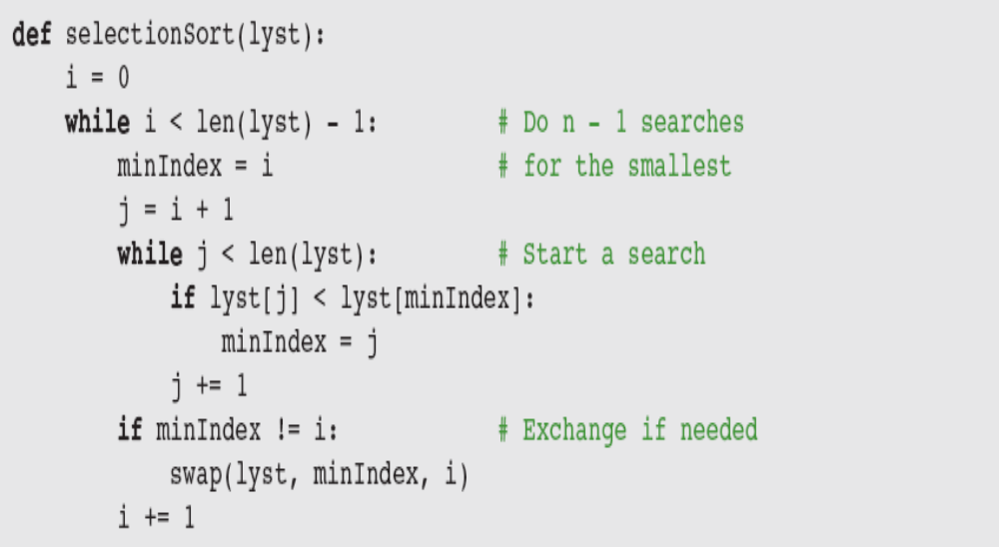
Selection Sort Pseudo Code

Slide 34
Selection Sort: Pass One
values [ 0 ]
[ 1 ]
[ 2 ]
[ 3 ]
[ 4 ]
36
24
10
6
12
U
N
S
O
R
T
E
D

Slide 35
Selection Sort: End Pass One
values [ 0 ]
[ 1 ]
[ 2 ]
[ 3 ]
[ 4 ]
6
24
10
36
12
SORTED
U
N
S
O
R
T
E
D

Slide 36
Selection Sort: Pass Two
values [ 0 ]
[ 1 ]
[ 2 ]
[ 3 ]
[ 4 ]
6
24
10
36
12
SORTED
U
N
S
O
R
T
E
D

Slide 37
Selection Sort: End Pass Two
values [ 0 ]
[ 1 ]
[ 2 ]
[ 3 ]
[ 4 ]
6
10
24
36
12
SORTED
U
N
S
O
R
T
E
D

Slide 38
Selection Sort: Pass Three
values [ 0 ]
[ 1 ]
[ 2 ]
[ 3 ]
[ 4 ]
6
10
24
36
12
SORTED
U
N
S
O
R
T
E
D

Slide 39
Selection Sort: End Pass Three
values [ 0 ]
[ 1 ]
[ 2 ]
[ 3 ]
[ 4 ]
6
10
12
36
24
S
O
R
T
E
D
UNSORTED

Slide 40
Selection Sort: Pass Four
values [ 0 ]
[ 1 ]
[ 2 ]
[ 3 ]
[ 4 ]
6
10
12
36
24
S
O
R
T
E
D
UNSORTED

Slide 41
Selection Sort: End Pass Four
values [ 0 ]
[ 1 ]
[ 2 ]
[ 3 ]
[ 4 ]
6
10
12
24
36
S
O
R
T
E
D

Slide 42
Selection Sort:
How many comparisons?
values [ 0 ]
[ 1 ]
[ 2 ]
[ 3 ]
[ 4 ]
6
10
12
24
36
4 comparisons for values[0]
3 comparisons for values[1]
2 comparisons for values[2]
1 comparison for values[3]
= 4 + 3 + 2 + 1

Slide 43
Insertion Sort in Real Life
Have you ever seen a teacher alphabetizing a couple dozen papers?
She takes a paper from an unsorted collection and place into a sorted collection in order
While playing cards, to sort the cards in the hand
We extract a card, shift the remaining cards and insert the extracted card in correct place

Slide 44
Insertion Sort
values [ 0 ]
[ 1 ]
[ 2 ]
[ 3 ]
[ 4 ]
36
24
10
6
12
Insert, one by one, each unsorted array element into its proper place.
On each pass, this causes the number of already sorted elements to increase by one.

Slide 45
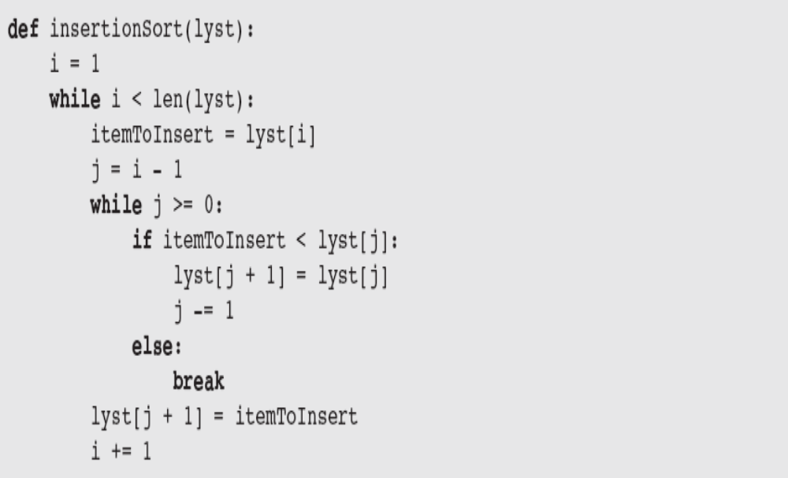
Insertion Sort Pseudo Code

Slide 46
Insertion Sort
Works like someone who “inserts” one more card at a time into a hand of cards that are already sorted.
To insert 12, we need to make room for it by moving first 36 and then 24.
6
10
24
36
12

Slide 47
Insertion Sort
Works like someone who “inserts” one more card at a time into a hand of cards that are already sorted.
To insert 12, we need to make room for it by moving first 36 and then 24.
6
10
24
36
12

Slide 48
Insertion Sort
Works like someone who “inserts” one more card at a time into a hand of cards that are already sorted.
To insert 12, we need to make room for it by moving first 36 and then 24.
6
10
24
36
12

Slide 49
Insertion Sort
Works like someone who “inserts” one more card at a time into a hand of cards that are already sorted.
To insert 12, we need to make room for it by moving first 36 and then 24.
12
24
6
10
36

Slide 50
Insertion Sort: Pass One
values [ 0 ]
[ 1 ]
[ 2 ]
[ 3 ]
[ 4 ]
36
24
10
6
12
SORTED
U
N
S
O
R
T
E
D

Slide 51
Insertion Sort: Pass Two
values [ 0 ]
[ 1 ]
[ 2 ]
[ 3 ]
[ 4 ]
24
36
10
6
12
SORTED
U
N
S
O
R
T
E
D

Slide 52
Insertion Sort: Pass Three
values [ 0 ]
[ 1 ]
[ 2 ]
[ 3 ]
[ 4 ]
10
24
36
6
12
S
O
R
T
E
D
UNSORTED

Slide 53
Insertion Sort: Pass Four
values [ 0 ]
[ 1 ]
[ 2 ]
[ 3 ]
[ 4 ]
6
10
24
36
12
S
O
R
T
E
D
UNSORTED

Slide 54
Insertion Sort: Pass Five
values [ 0 ]
[ 1 ]
[ 2 ]
[ 3 ]
[ 4 ]
6
10
12
24
36
S
O
R
T
E
D

Slide 55
A sample Python code for Insertion Sort
>>> def insertionSort(alist):
for index in range(1,len(alist)):
currentvalue = alist[index]
position = index
while position>0 and alist[position-1]>currentvalue:
alist[position]=alist[position-1]
position = position-1
alist[position]=currentvalue
alist = [54,26,93,17,77,31,44,55,20]
insertionSort(alist)
print(alist)
Output: >>> runfile('C:/Users/Vijay/.spyder2/.temp.py', wdir=r'C:/Users/Vijay/Desktop/Python Today')
[17, 20, 26, 31, 44, 54, 55, 77, 93]
Insertion Sort Animation: http://cs.armstrong.edu/liang/animation/web/InsertionSort.html

Slide 56
Exercise 1
Given a sorted list with an unsorted number V in the rightmost cell, can you write some simple code to insert V into the array so that it remains sorted? Print the array every time a value is shifted in the array until the array is fully sorted.
Guideline: You can copy the value of V to a variable and consider its cell "empty". Since this leaves an extra cell empty on the right, you can shift everything over until V can be inserted.

Slide 57
Exercise 2
Using the same approach as exercise 1, sort an entire unsorted array?
Guideline: You already can place an element into a sorted array. How can you use that code to build up a sorted array, one element at a time? Note that in the first step, when you consider an element with just the first element - that is already "sorted" since there's nothing to its left that is smaller.
In this challenge, don't print every time you move an element. Instead, print the array after each iteration of the insertion-sort, i.e., whenever the next element is placed at its correct position.
Since the array composed of just the first element is already "sorted", begin printing from the second element and on.

